Slide 1
VLSI DESIGN
LECTURE 12
BE(ECE)5TH SEMESTER

Slide 2
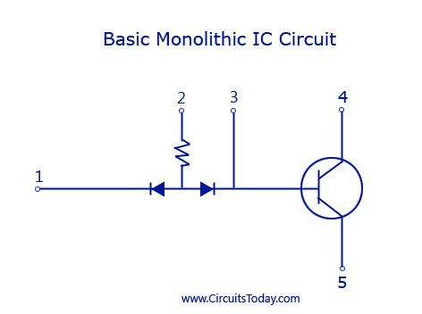
Monolithic IC’s
With basic components like resistor,
diode, and transistor a basic circuit is
first made.
The basic structure of a monolithic IC will have 4 layers of different materials.
The base layer will be a P-type silicon layer and is named as the substrate layer.
This layer will have a typical thickness of 200 micrometer.
Silicon is the preferred semiconductor for the P-type and N-type layer because of its favourable characteristics for the manufacturing of an IC.

Slide 3
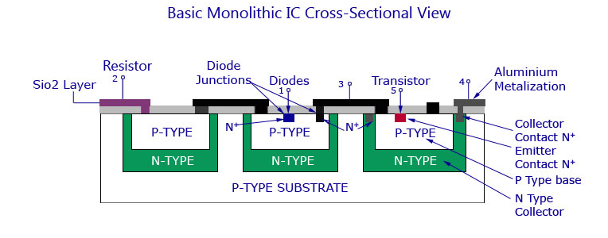
The layer above the substrate P-type silicon layer is the N-type layer.
All the active and passive components required for the circuit are fabricated onto this layer.
This layer has a typical thickness of 25 micrometer.
The N-type silicon material is grown as a single crystal extension of the P-layer and the components are required are fabricated using series of P-type and N-type impurity diffusions.

Slide 4
The layer above N-type is made of silicon dioxide (SiO2) material.
Since there is a selective P-type and N-type impurity diffusion going on in the second layer, this layer acts as a barrier in the process.
This layer is etched away from the region where diffusion is desired to be permitted with photolithographic process.
The rest of the wafer remains protected against diffusion. This layer also protects the silicon layer from contamination.
The up-most layer is that made of aluminium. This metallic layer is used to provide interconnections between the different components used in the IC.

Slide 5
Monolithic IC Manufacturing Process
P-layer Substrate Manufacture
Being the base layer of the IC, the P-type is silicon is first built for the IC.
A silicon crystal of P-type is grown in dimensions of 250mm length and 25mm diameter.
The silicon is then cut into thin slices with high precision using a diamond saw.
Each wafer will precisely have a thickness of 200 micrometer and a diameter of 25 mm.
These thin slices are termed wafers. These wafers may be circular or rectangular in shape with respect to the shape of the IC.
After cutting hundreds of them each wafer is polished and cleaned to form a P-type substrate layer.

Slide 6
N-type Epitaxial Growth
The epitaxial growth process of a low resistive N-type over a high resistive P-type is to be carried out.
This is done by placing the n-type layer on top of the P-type and heating then inside a diffusion furnace at very high temperature (nearly 1200C).
After heating, a gas mixture of Silicon atoms and pentavalent atoms are also passed over the layer. This forms the epitaxial layer on the substrate.
All the components required for the circuit are built on top of this layer. The layer is then cooled down, polished and cleaned.

Slide 7
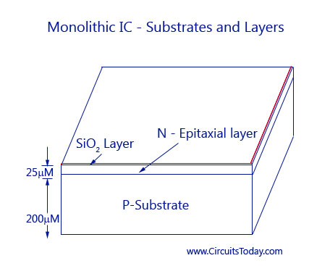
The Silicon Dioxide Insulation Layer
This layer is only 1 micrometer thin and is grown by exposing the epitaxial layer to oxygen atmosphere at 1000C.
A detailed image showing the P-type, N-type epitaxial layer and SiO2 layer is given below.

Slide 8
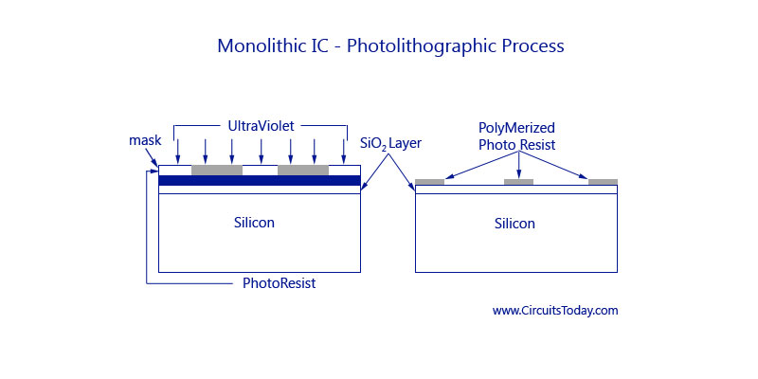
Photolithographic Process for SiO2
To diffuse the impurities with the N-type epitaxial region, the silicon dioxide layer has to be etched in selected areas.
Thus openings must be brought at these areas through photolithographic process.
In this process, the SiO2 layer is coated with a thin layer of a photosensitive material called photoresist.

Slide 9
A large black and white pattern is made in the desired pattern, where the black pattern represents the area of opening and white represents the area that is left idle.
This pattern is reduced in size and fit to the layer, above the photoresist.
The whole layer is then exposed to ultraviolet light.
Due to the exposure, the photoresist right below the white pattern becomes polymerized.
The pattern is then removed and the wafer is developed using a chemical like trichloroethylene.

Slide 10
The chemical dissolves the unpolymerized portion of the photoresist film and leaves the surface.
The oxide not covered by polymerised photoresist is then removed by immersing the chip in an etching solution of HCl.
Those portions of the Si02 which are protected by the photoresist remain unaffected by the acid.
After the etching and diffusion process, with the help of chemical solvents like sulphuric acid, the resist mask is then removed by mechanical abrasion.
The appropriate impurities are then diffused through oxide free windows.

Slide 11
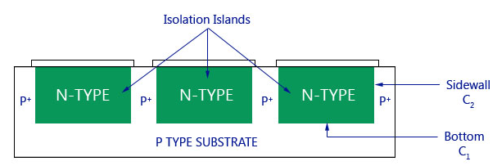
Isolation Diffusion
After photolithographic process the remaining SiO2 layer serves as a mask for the diffusion of acceptor impurities.
To get a proper time period for allowing a P-type impurity to penetrate into the N-type epitaxial layer, isolation diffusion is to be carried out.
By this process, the P-type impurity will travel through the openings in SiO2 layer, and the N-type layer and thus reach the P-type substrate, Isolation junctions are used to isolate between various components of the IC.

Slide 12
The temperature and time period of isolation diffusion should be carefully monitored and controlled.
As a result of isolation diffusion, the formation of N-type region called Isolation Island occurs.
Each isolated island is then chosen to grow each electrical component.
From the figure below you can see that the isolation islands look like back-to-back P-N junctions.
The main use of this is to allow electrical isolation between the different components inside the IC.
Each electrical element is later on formed in a separate isolation island.
The bottom of the N-type isolation island ultimately forms the collector of an N-P-N transistor.

Slide 13
An effect of capacitance is produced in the region where the two adjoining isolation islands are connected to the P-type substrate.
This is basically a parasitic capacitance that will affect the performance of the IC.
This kind of capacitance is divided into two. As shown in the figure C1 is one kind of capacitance that forms from the bottom of the N-type region to the substrate and capacitance C2 from the sidewalls of the isolation islands to the P-region.
The bottom component C1 is essentially due to step junction formed by epitaxial growth and, therefore, varies as the square root of the voltage V between the isolation region and substrate.
The sidewall capacitance C2 is associated with a diffused graded junction and so varies as (-1/2) exponential of V.
The total capacitance is of the order of a few picoFarads.

Slide 14
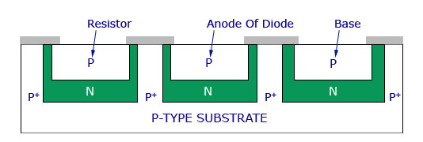
Base Diffusion
This process is done to create a new layer of SiO2 over the wafer.
P-regions are formed under regulated environments by diffusing P-type impurities like boron.
This forms the base region of an N-P-N transistor or as well as resistors, the anode of diode, and junction capacitor.
In this case, the diffusion time is so controlled that the P-type impurities do not reach the substrate.
The resistivity of the base layer is usually much higher than that of the isolation regions.

Slide 15
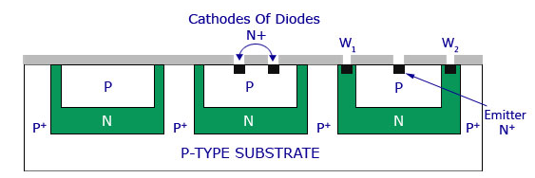
Emitter Diffusion
Masking and etching process is again carried out to form a layer of silicon dioxide over the entire surface and opening of the P-type region.
The transistor emitters, the cathode regions for diodes, and junction capacitors are grown by diffusion using N-type impurities like phosphorus through the windows created through the process under controlled environmental process.
As shown in the figure, there are two additional windows: W1 and W2.
These windows are made in the N-region to carry an aluminium metallization process.

Slide 16
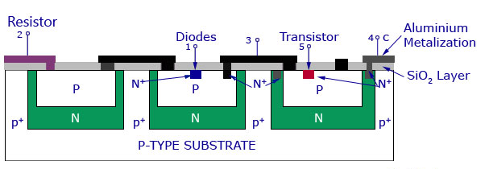
Aluminium Metallization
The windows made in the N-region after creating a silicon dioxide layer are then deposited with aluminium on the top surface.
The same photoresist technique that was used in photolithographic process is also used here to etch away the unwanted aluminium areas.
The structure then provides the connected strips to which the leads are attached.

Slide 17
Scribing and Mounting
After the metallization process, the silicon wafer is then scribed with a diamond tipped tool and separated into individual chips.
Each chip is then mounted on a ceramic wafer and is attached to a suitable header.
Next the package leads are connected to the IC chip by bonding of aluminium or gold wire from the terminal pad on the IC chip to the package lead.
Thus the manufacturing process is complete.

